Slide 1
Features X
Response Y
Confounding e
Instrument Z
Policy P

Slide 2
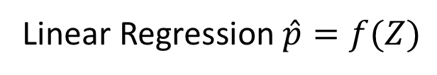

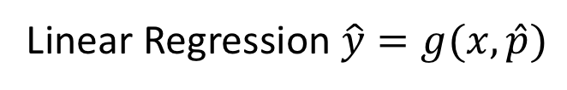
Linear Regression $\hat{y}=g(x,\hat{p})$
Features X
Response Y
Con-founding e
Instrument Z
Policy Estimate $\hat{P}$
Linear Regression $\hat{p}=f(Z)$

Slide 3
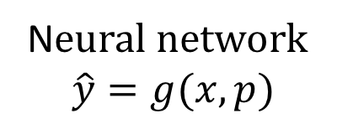
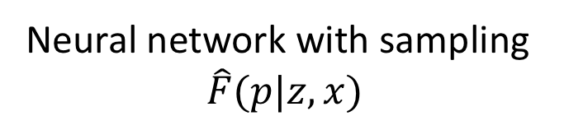
N$eural network$
$$\hat{y}=g(x,p)$$
Features X
Response Y
Con-founding e
Instrument Z
Policy P
Neural network with sampling
$$\hat{F}(p|z,x)$$

